Slide 1
Doing Cultural Resource Management Your Way: Webinar Outline
Dennis Griffin – Oregon State Historical Preservation Office, retired
Misty Jackson – Arbre Croche Cultural Resources LLC
Chat Q&A
Summary
We will get started at 1:00 p.m. EDT!

Slide 2
Elizabeth Briody Visual Description
I am Elizabeth Briody, a white woman with brown eyeglasses and short hair. Today I am wearing a blue top. I am in my alcove, a little space in my house with a window.

Slide 3
Pathways to Careers
Welcome to the AAA Career Webinar Series
Spring 2021

Slide 4
AAA Career Webinar Series, Spring 2021
March 4: Career Pathways
March 11: User Experience Jobs from the Inside Out
March 18: Anthropologists Working in Hospital Settings
March 25: Doing Cultural Resource Management Your Way
April 1: Contemplating a Career in Tech?
April 8: Careers in the Public Sector
April 15: Using Archaeological and Anthropological Skill Sets as Accessible Designers
April 22: Anthropologists Building Careers in GIS

Slide 5
Webinar Logistics
Visual descriptions appear in slide deck along with presenters’ self-introductions and comments
Please turn off your video and microphone unless speaking
Open and use the Chat function; write “QUESTION” to pose a question and feel free to respond to any chat
See postings on the webinar’s Communities: 1) Career webinar recordings, 2) PPT slide decks, 3) Resources, 4) Chat Q&As

Slide 6
Doing Cultural Resource Management Your Way
Thursday, March 25, 2021

Slide 7
Doing Cultural Resource Management Your Way: Webinar Outline Review
Dennis Griffin – Oregon State Historical Preservation Office, retired
Misty Jackson – Arbre Croche Cultural Resources LLC
Chat Q&A
Summary

Slide 8
Dennis Griffin Visual Description
I am Dennis Griffin, an older, white male with white, shoulder length hair, beard and glasses. Today I am wearing a blue shirt and contacting you from my office which is located in my backyard in Oregon.

Slide 9
My career in Cultural Resource Management
40+ years working in CRM in the Pacific Northwest and globally;
Archaeologist with U.S. Forest Service & Bureau of Land Management, and archaeologist/oral historian with Bureau of Indian Affairs;
Tribal archaeologist and consultant to several other tribes;
Owner or co-owner of two cultural resource consulting firms;
State Archaeologist, Oregon State Historic Preservation Office (18 years).

Slide 10
My Education
PhD in archaeology, MA in Interdisciplinary Studies (Archaeology, Cultural Anthropology, & Historic Preservation) and two BS degrees
Student internships with several tribes and served as a university research and teaching assistant.
My anthropological training has had a direct influence on every job I have had during my career. Working with and learning from Tribes has had the greatest influence.

Slide 11
What is Cultural Resource Management?
Survey, testing, excavation, and mitigation of cultural resources;
Requires collecting background research, talking to local informants, consulting with tribes, analyzing prehistoric and historic artifacts, writing reports, and publishing results.

Slide 12
Basic Requirements to Find CRM Work
Bachelor’s degree in Anthropology minimally required;
Master’s degree to be crew leader;
Field school;
Ability to write and work with others in a team.

Slide 13
Working in CRM
Needs
Outcomes
Love of outdoors; OK getting dirty
Love of history & solving puzzles
More skills = greater opportunity to work
Interest in a challenge
Money is not that important
Travel and work in exotic places
Create scenarios from ltd. info.
Lead projects; on-job training available
Days are rarely ever boring
Will love what you do

Slide 14
Skill and Education Recommendations
Acquire helpful ancillary skills: geology, soils, faunal analysis, GIS, remote sensing, photography, reading a map, using a compass;
Gain as many archaeology skills from as many venues as possible (e.g., federal government, tribes, contractors);
Get a Master’s degree in anthropology and write a thesis dealing with some component related to field research.

Slide 15
Work-Related Recommendations
Future jobs depend on where you previously worked, number and type of projects, and skills you have to offer;
Volunteering really helps (e.g., internships, summer work, student projects);
Work for a Tribe in some capacity since that experience will influence the rest of your career;
If a job is worth doing, people have a right to know about it. Plan on sharing project results through conferences and publications.

Slide 16
Misty Jackson Visual Description
I am a Euro-American woman with long brown/blonde hair, brown eyes, and eyeglasses. I am in my living room, with a wood room divider in front of a window.

Slide 17
What are the kinds of tasks associated with CRM? (Part I)
National Historic Preservation Act of 1966
Secretary of the Interior Standards for:
◦ History
◦ Archaeology
◦ Architectural History
◦ Architecture
◦ Historic Architecture

Slide 18
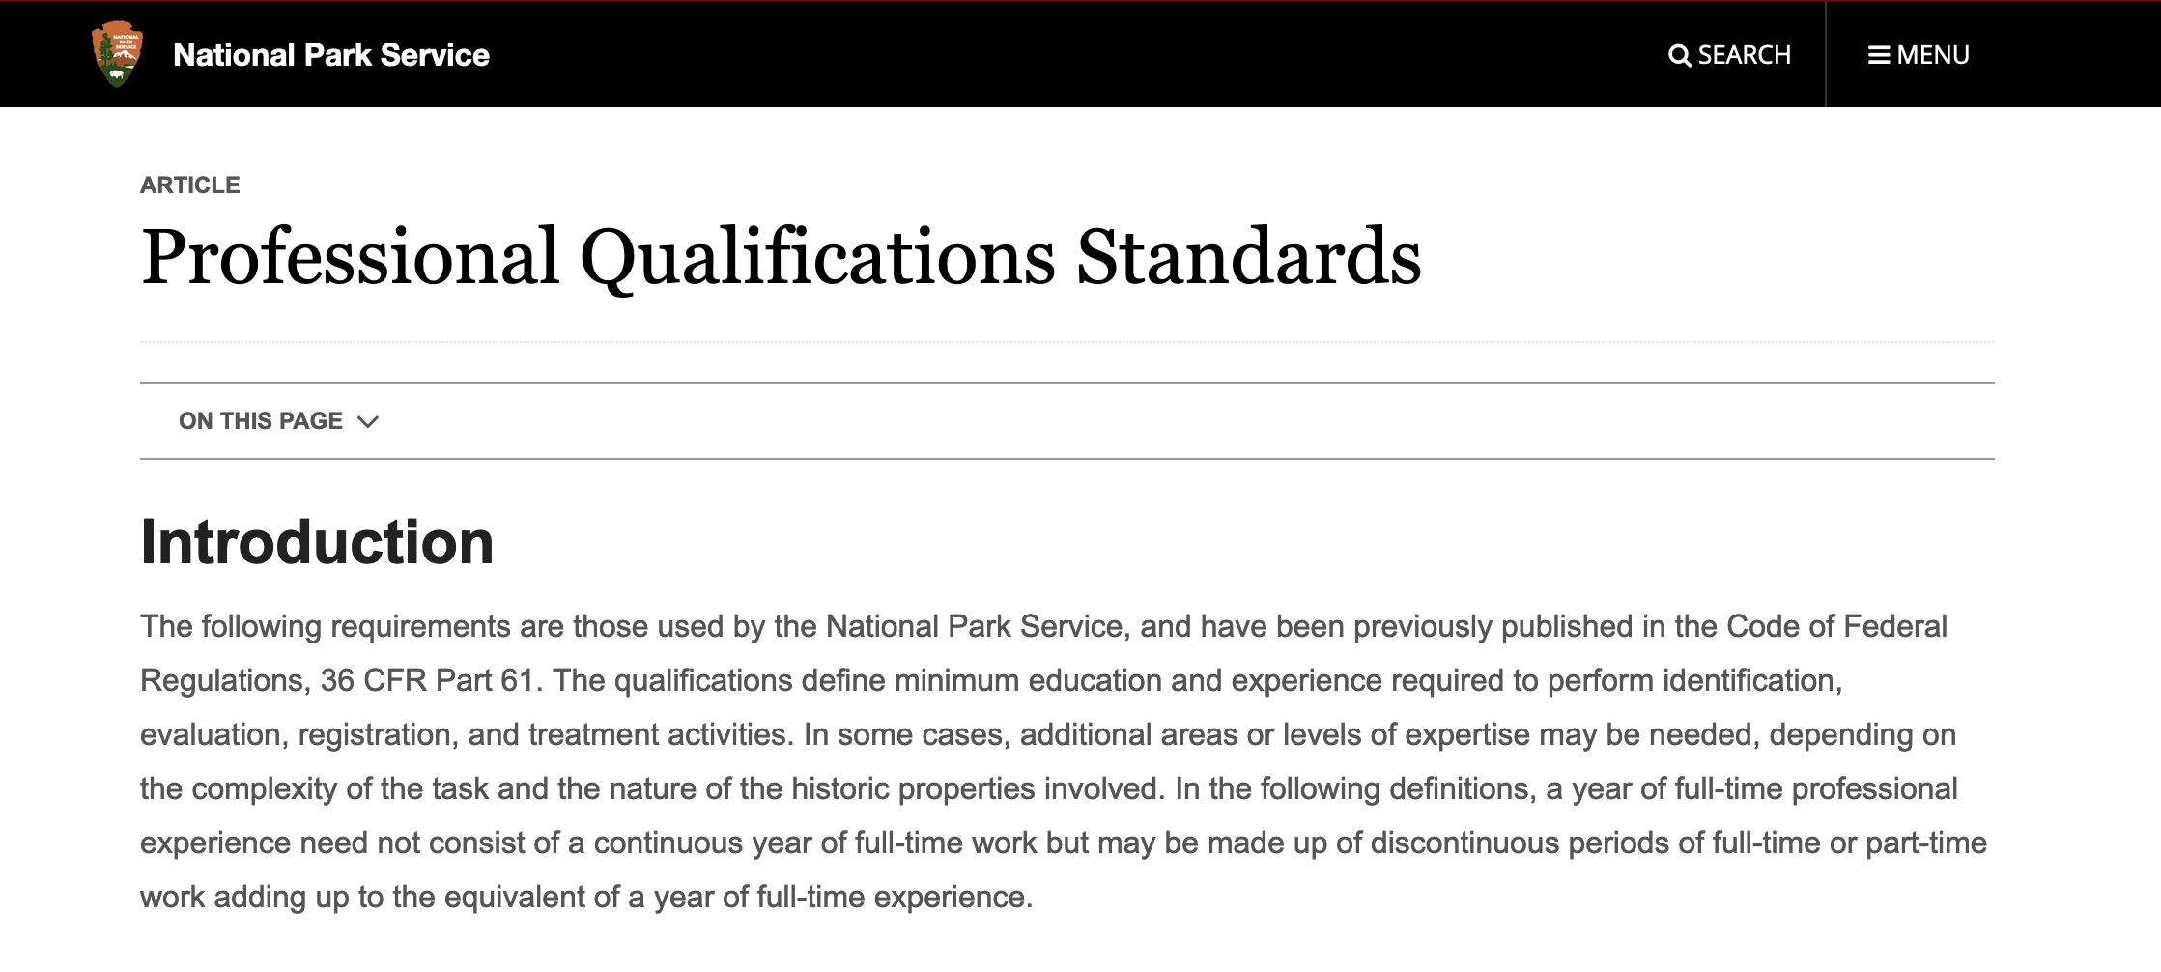
What are the kinds of tasks associated with CRM? (Part II)
National Historic Preservation Act of 1966
https://www.nps.gov/articles/sec-standards-prof-quals.htm

Slide 19
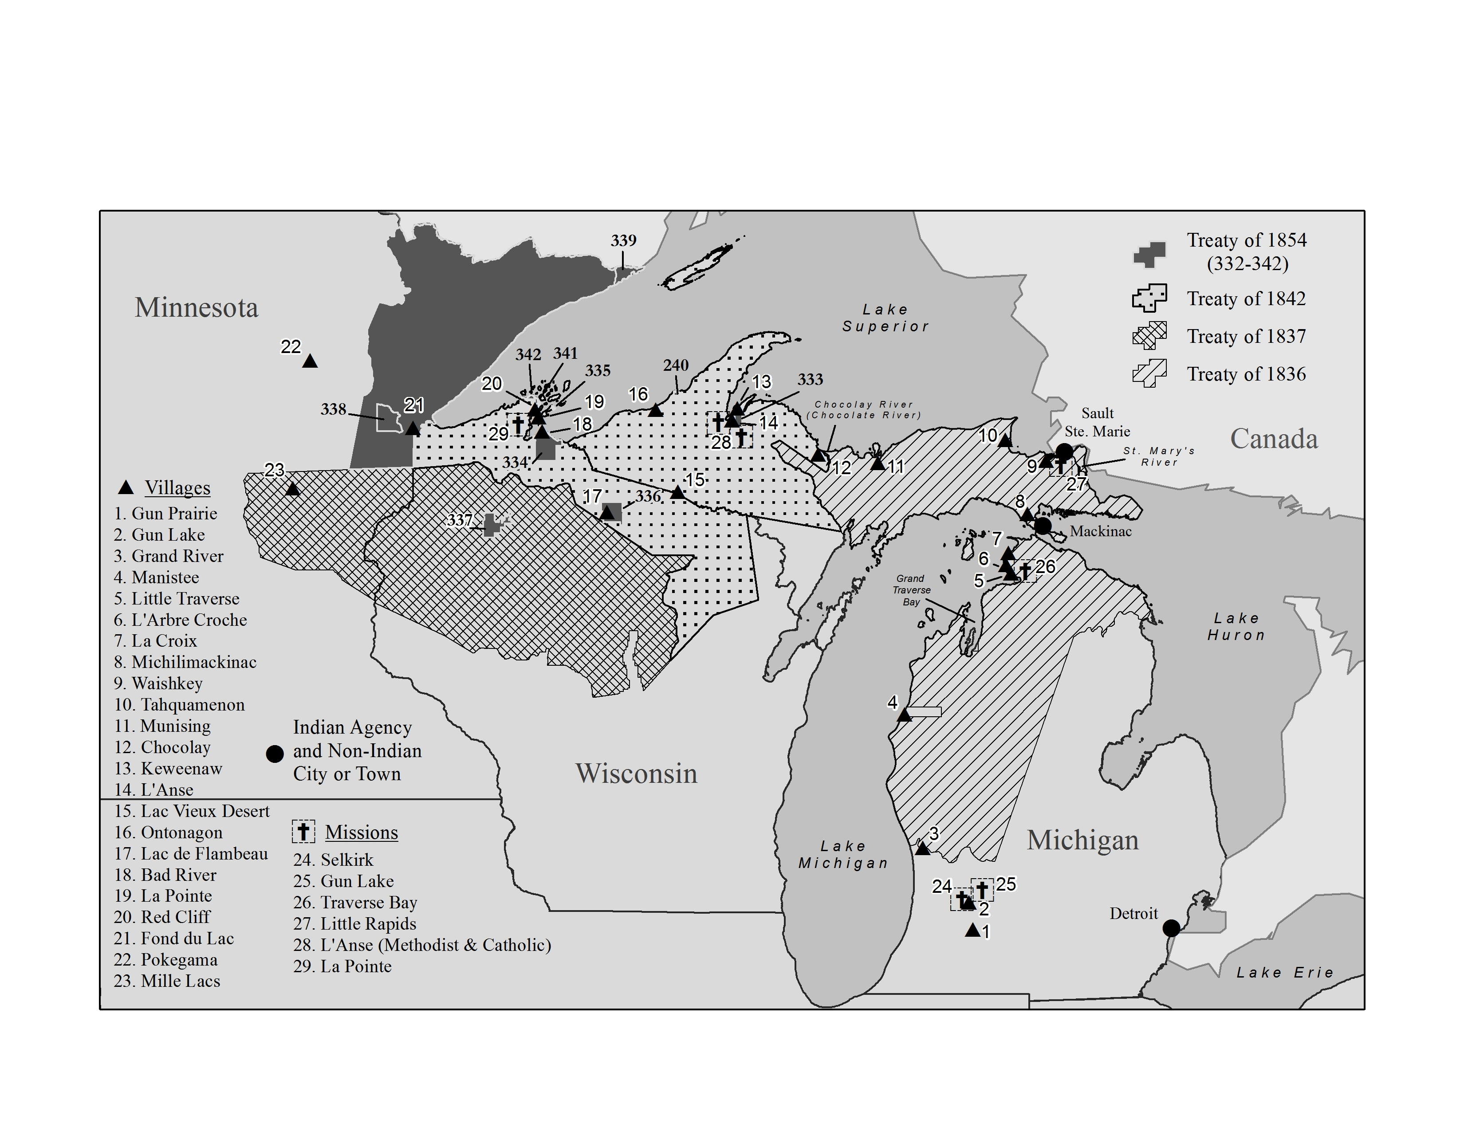
What are the kinds of tasks associated with CRM? (Part III)
Ethnohistorical research/Native American treaty related projects
Map of treaties & villages included
in the research for
a 2014-2015 treaty case for a
member of the
Keweenaw Bay Indian Community

Slide 20
Secretary of the Interior’s Standards for archaeology
Archaeology’s minimum professional qualifications are a graduate degree in archeology, anthropology, or closely-related field plus:
At least one year of full-time professional experience or equivalent specialized training in archeological research, administration, or management;
At least four months of supervised field and analytic experience in general North American archeology, and
Demonstrated ability to carry research to completion.

Slide 21
How did I get into CRM in the first place?
Indiana State University,
Terre Haute, Indiana

Slide 22
When did I decide to start my own CRM firm? Why?
First time: 2000 while in grad school on behalf of a colleague, for the:
Second time: 2007 after getting Ph.D. and teaching as an adjunct

Slide 23
How do you find clients and how do they find you? Part I
States keep lists of qualified consultants (Secretary of the Interior qualifications)
Federal Government:
Small Business Administration (SBA),
Woman-Owned Small Business (WOSB),
Economically Disadvantaged Woman-Owned Small Business (EDWOSB)
Contract Opportunities at https://beta.sam.gov/

Slide 24
How do you find clients and how do they find you? Part II
Marketing push – actively engaging potential clients
Referrals: Farm Service Agency (FSA, part of USDA) – small clients
Repeat clients: Do a good job, and they will come back
Your website

Slide 25
What is a typical/composite day Like? (Part I)
Emails and phone calls to clients, State Historic Preservation Office (SHPO), crew, colleagues (architectural historians)
Proposal and contract writing
Invoicing, insurance and bank-related matters
Report writing
Section 106 review application assessments

Slide 26
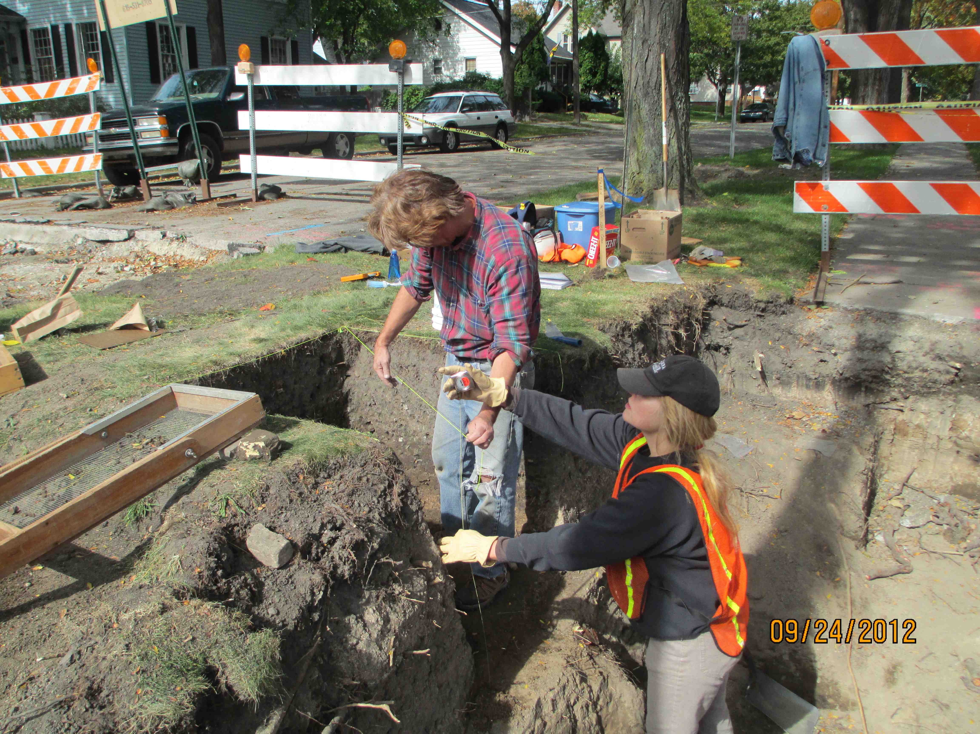
What is a typical/composite day Like? (Part II)
Sometimes fieldwork
(Secretary of the Interiors Standards, again)
Sometimes artifact analysis and other research
Crew member Maynard Lockwood & me,
N. Michigan Avenue, Saginaw, Michigan water
main replacement monitoring and Phase II testing.

Slide 27
How has your work changed during COVID?
Archaeologists in CRM are “essential workers.”
Maintaining social distance is not that hard when you work outside, but….
Just as much and even more work in 2020.

Slide 28
Some things to Consider:
Additional training and certifications through:
and
- Certificate program in Heritage Business Management
- Introduction to professional ethics and developing your ethical knowledge

Slide 29
Chat Q&A and Summary

Slide 30
Summary 1: CRM Jobs
CRM can be done with a BA/BS, but an MA/MS enables advancement
Only one half of CRM tasks involve working outside; the remainder entail research gathering, analysis, and writing
CRM relies on those with a curiosity about history, an ability to piece together clues to explain the past, and a willingness to admit that their hypotheses did not hold

Slide 31
Summary 2: CRM Jobs
Get as much experience in the field as you can, and prove that you are good at writing; both are much needed skills.
Continue to get certifications, including on ethics; the CRM world should not be just about money.
Find a mentor, even if I means volunteering.

Slide 32
Closing Remarks
Complete evaluation of this webinar, emailed to you
See postings on the webinar’s Communities: 1) Career webinar recordings, 2) PPT slide decks, 3) Resources, 4) Chat Q&As
Register for our other career webinars this Spring

Slide 33
Upcoming AAA Career Webinar Series
April 1: Contemplating a Career in Tech?
April 8: Careers in the Public Sector
April 15: Using Archaeological and Anthropological Skill Sets as Accessible Designers
April 22: Anthropologists Building Careers in GIS

