Slide 1
AAA Strategic Planning
Town Hall – May 2021

Slide 2
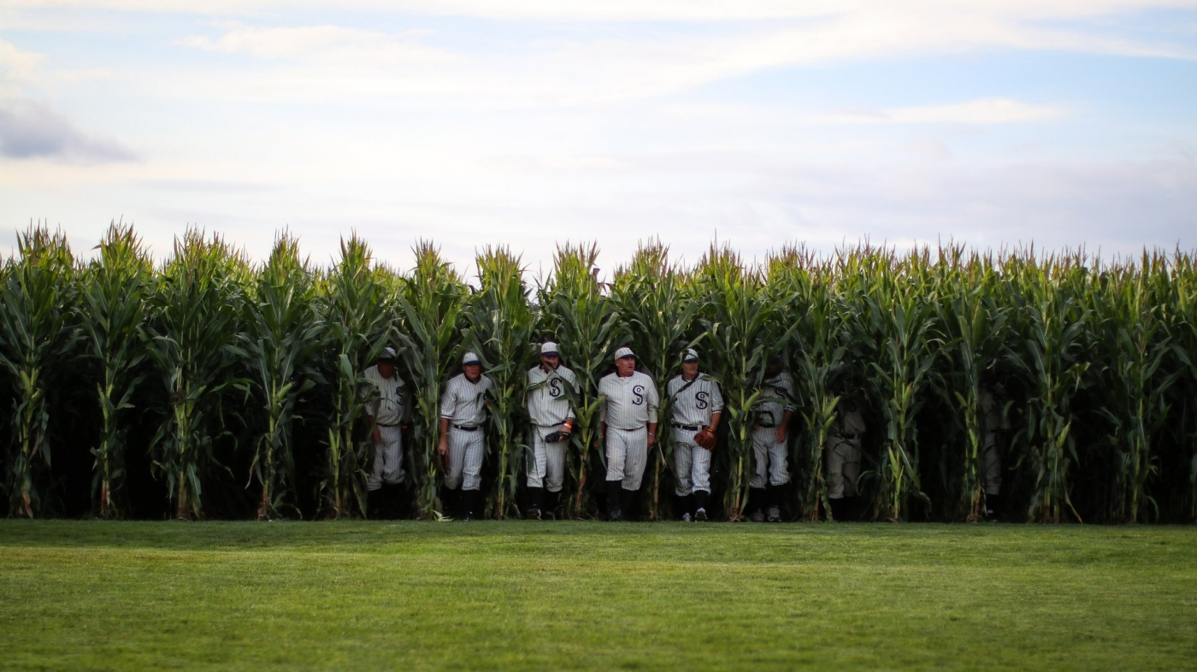
The Field of Dreams approach – Just say ‘No’

Slide 3
Foundational considerations
Mission – advance the field as the discipline of research, practice, and teaching that increases our understanding of humankind, and applies this understanding to addressing the world’s most pressing problems.
Vision – to enrich the discipline’s intellectual terrain, challenging ourselves to dismantle the barriers that have hobbled entry and career advancement for scholars and practitioners, with special focus on people from historically under-represented categories.
Core Values – community, quality (intellectual as well as member services), breadth and diversity of content, accessibility, sustainability.

Slide 4
Strategic Focus Areas, 2021-2026
Knowledge Exchange: To promote the global exchange of anthropological knowledge and its practical implications through meetings, conferences, technical reports, visual and performance forms publishing activities that emphasize intellectual rigor, originality, inclusiveness, and accessibility of the field’s core knowledge base.
Growth for Inclusion: To grow the Association’s membership by retaining existing members and attracting new members through equitable inclusion that reflects the diversity of the discipline and dismantles barriers to entry and advancement on the part of members of historically under-represented groups.
Anthropologists in Practice Settings: To make the Association a more welcoming organizational home for anthropologists working (or aspiring to work) in business, government, and non-profit settings through a member value proposition that recognizes a diverse range of career trajectories and reward structures.
Education, Outreach, and Advocacy: To increase awareness on the part of prospective employers, media, public policy officials, and the general public of anthropological scholarship and practice through outreach, advocacy and policy making, and public education initiatives.

Slide 5
Questions for you about AAA’s next 5 years:
Do you see anything at this top level that shouldn’t be there?
Is something missing that ought to be included?
Among the general priority areas - as proposed or modified - what are we doing that we should be doing more of in the next five years, or differently?
What specific things should we do in next five years that we’re not?

Slide 6
Your turn
Questions, Comments, Suggestions?

